Slide 1

E – Commerce and Delivery Analytics
BY GROUP 6
[Code: DA – P1063 ]

Slide 2

PROJECT TEAM
Team Members:
GLAVIN SHRINEMENEZES
MADAN N
CHETHAN M
KONGARAPU PRUTHVI BABU
SHILPA S DESAI
SHAIK GOUSE PEERA
SRUTHY PREMANAND

Slide 3
INTRODUCTION
A Data-Driven Approach to Understanding Customer Behavior, Delivery Performance & Payment Trends.
Tools used:
    Excel
    Power BI
    Tableau
    SQL (for query execution only)

Slide 4
DATA OVERVIEW
The objective of this project was to analyze customer purchasing behavior, payment preferences, delivery performance, and review scores to derive insights that help improve business operations and customer satisfaction.
Project Focus Areas:
Analyze sales patterns across time periods
Study delivery delays and category performance
Understand relationship between review score & delivery time
Compare weekday vs weekend payment trends
Validate dashboard insights through SQL queries

Slide 5
ANALYSIS
Payment Behavior: Majority of transactions and revenue occur on weekdays, with credit cards being the most preferred payment method
Delivery Performance: Average delivery time is ~12 days, with certain categories showing high delays leading to lower review ratings
Customer Satisfaction: There is a strong negative relationship between delivery delays and review scores
Geographical Trends: São Paulo contributes the highest order value
Revenue Insights: Return customers provide more consistent revenue compared to new customers

Slide 6
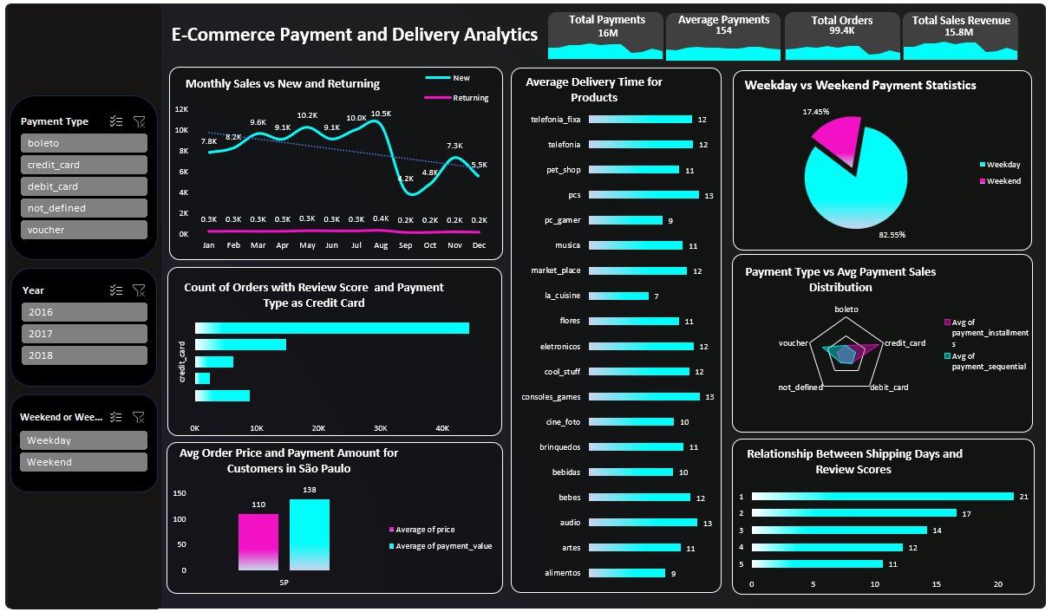
EXCEL DASHBOARD
Key Insights from Excel Dashboard
Peak sales in June and August
Weekday payments account for ~77% of transactions
Credit card is the most frequently used payment method
São Paulo customers have the highest average order price
Categories like Office Furniture & Electronics face long delivery times

Slide 7
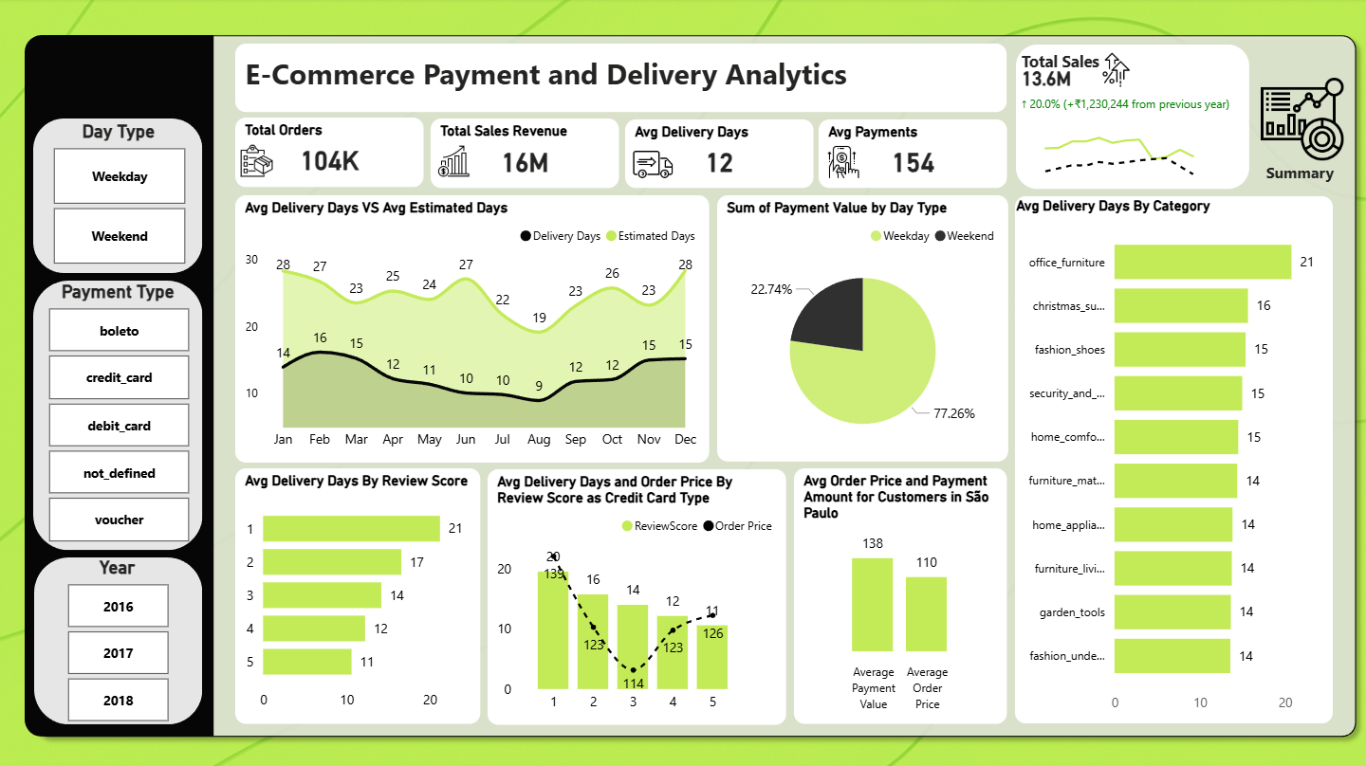
POWER BI DASHBOARD
Key Insights from Power BI Dashboard
Average delivery time: 12 days
Review score declines sharply when delivery time increases beyond 15 days
Clear difference between estimated vs actual delivery days
Strong relationship between delivery experience and customer satisfaction
Average payment value: 154

Slide 8
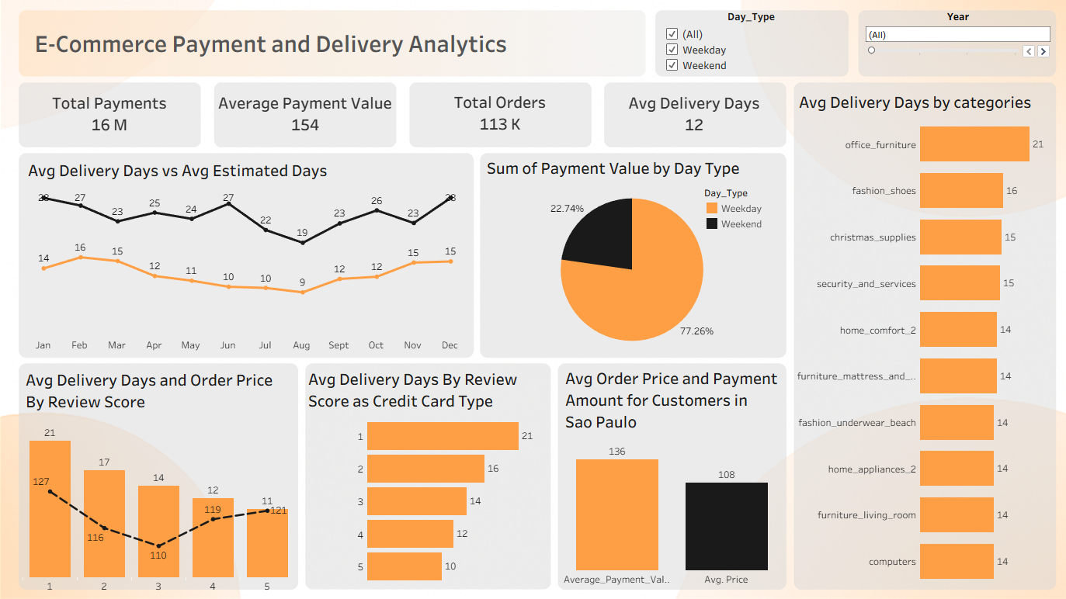
TABLEAU DASHBOARD
Key Insights from Tableau Dashboard
77% of total revenue comes from weekday transactions
Delivery performance varies heavily by category (up to 21 days)
Payment amount distribution shows credit card customers pay more
Review Score 1 & 2 are strongly linked to delivery delays

Slide 9
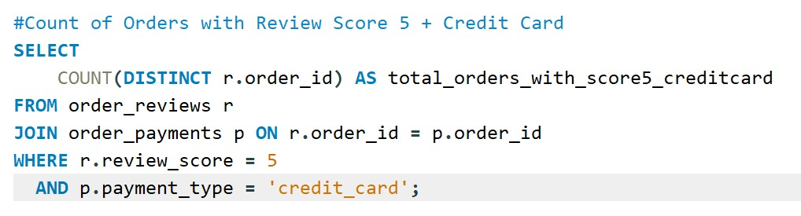
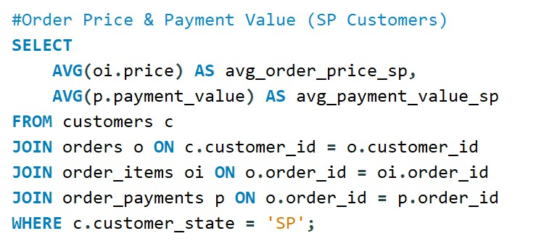
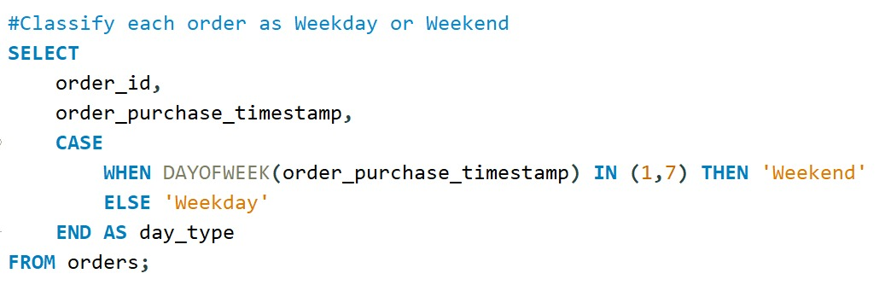
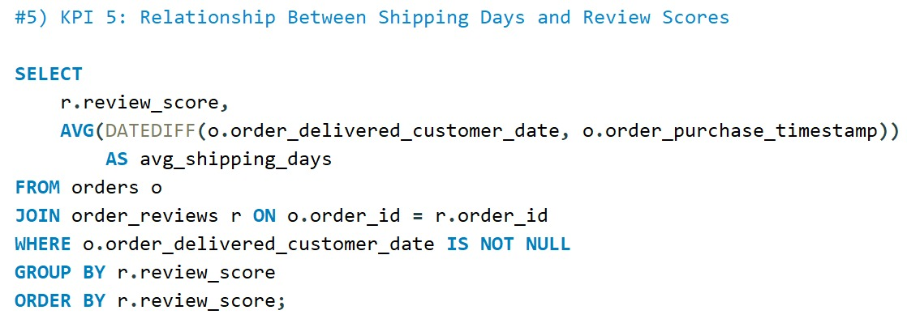
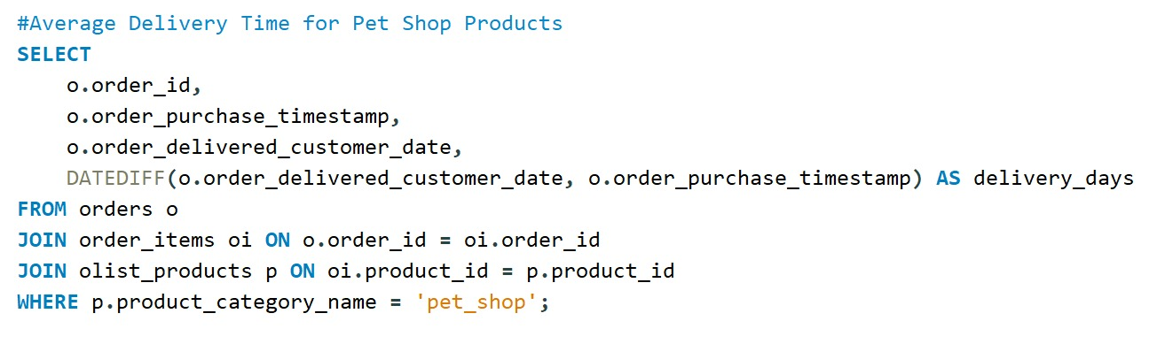
SQL - QUERIES
SQL Focus Areas
Extracted KPIs: Total Payments, Total Orders, Avg Payment Value
Compared weekday vs weekend payment value
Calculated avg delivery days by category
Analyzed review score vs delivery time
Validated dashboard visuals by reproducing results in SQL outputs

Slide 10
Key Insights Gained About E-Commerce
Customer experience is everything — delivery speed and service quality strongly affect review scores and repeat purchases.
Payment preferences impact revenue — credit card users spend more on average than other payment methods.
Weekday sales dominate, showing that working professionals drive most transactions.
Data helps improve operations — insights enable better decisions in delivery planning, inventory, and promotions.
Return customers hold higher value, so businesses must focus on loyalty and retention strategies.

Slide 11
RECOMMENDATIONS
Improve logistics & delivery efficiency, especially for high-delay categories like Office Furniture and Electronics
Introduce weekday-focused promotions, since most sales occur Monday–Friday
Strengthen credit-card based loyalty and cashback programs to boost revenue from high-value paying customers
Monitor delivery performance KPIs regularly to prevent customer dissatisfaction and negative review scores
Focus on retaining repeat customers with membership plans, faster delivery options, or exclusive discounts

Slide 12
INSIGHTS AND CONCLUSIONS
This project helped uncover critical insights that can improve operational efficiency and customer satisfaction in e-commerce:
Delivery delays significantly harm review scores & repeat buying
Credit card promotions can increase revenue
Weekday campaigns offer better conversion than weekend traffic
Business must prioritize categories with longest delivery issues

Slide 13
THANK YOU

